Slide 1
深度學習 Pytorch手把手實作 物件偵測
義隆電子 人工智慧研發部 黃志勝

Slide 2
Introduction
Brief Introduction
直覺的方式建立自己的物件偵測模型
YOLOv1

Slide 3
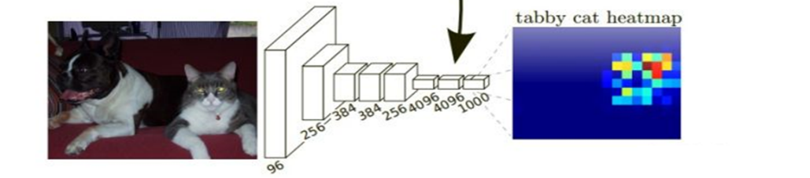
Deep Learning: Feature Extractor
Feature map可以做什麼?
這張圖是貓還是夠 (Classification)
框出圖片內有貓和狗的位置 (Object detection)
從框出的物件(貓和狗)中的描繪出實際物件的輪廓 (Instance Segmentation)
把圖片描繪出物件(貓和狗)的輪廓 (Semantic Segmentation)
h
Feature Map
w
1000 channel

Slide 4
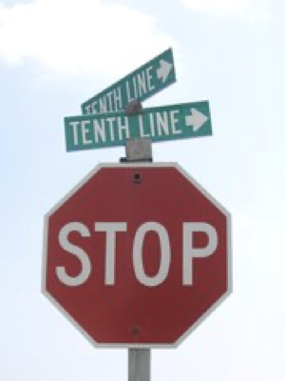
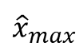
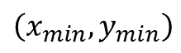
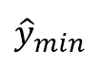
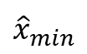
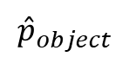

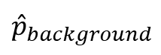
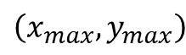
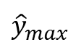
物件偵測
$${\hat{x}}_{min}$$
$${\hat{y}}_{min}$$
GAP
$${\hat{x}}_{max}$$
Backbone NetWork
$${\hat{y}}_{max}$$
h
Feature Map
…
w
$${\hat{p}}_{background}$$
$${\hat{p}}_{object}$$
channel
$$\left(x_{max},y_{max}\right)$$
$$\left(x_{min},y_{min}\right)$$
$$物件$$

Slide 5
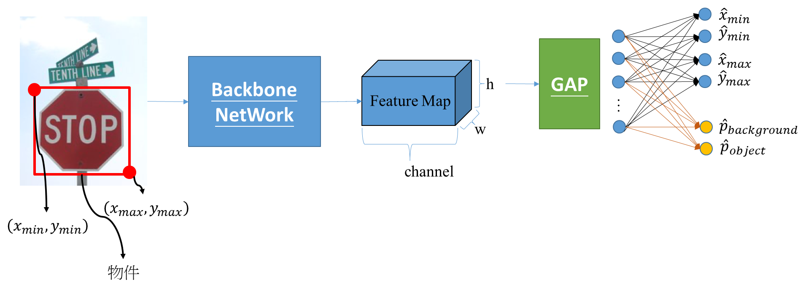
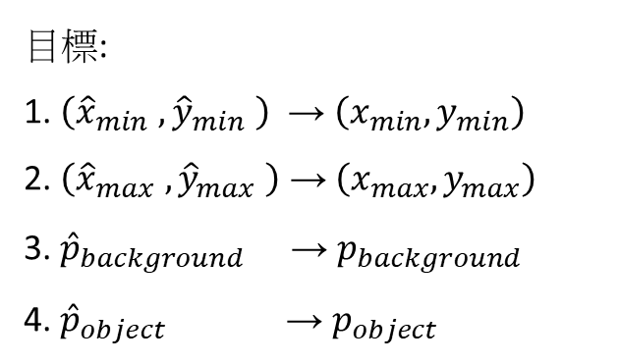
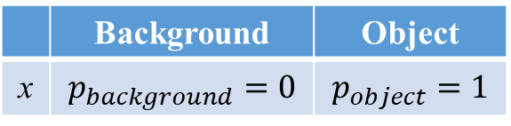
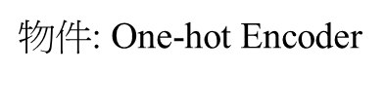
物件偵測
Boundary Box
Class Confidence
目標:
1. $\left({\hat{x}}_{min} ,{\hat{y}}_{min} \right)$ → $\left(x_{min},y_{min}\right)$
2. $\left({\hat{x}}_{max} ,{\hat{y}}_{max} \right)$ →$\left(x_{max},y_{max}\right)$
3. ${\hat{p}}_{background}$ → $p_{background}$
4. ${\hat{p}}_{object}$ → $p_{object}$
Regerssion: MSE
$物件$: One-hot Encoder
 | Background | Object
x | $$p_{background}=0$$ | $$p_{object}=1$$
Classification: Cross Entropy
最小化 {MSE (Regression)+Cross Entropy (Classification)}

Slide 6
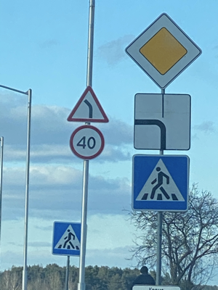
上述的架構會有問題
物件數超過1 ????

Slide 7
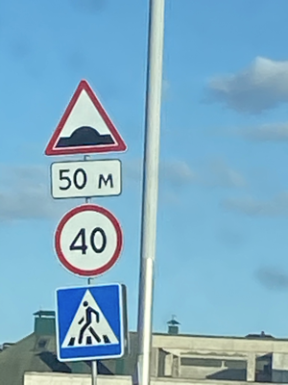
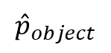
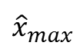
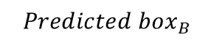
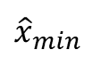
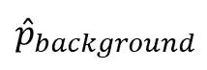
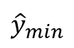
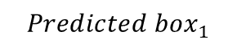
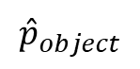
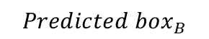
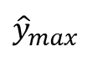
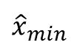
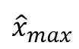
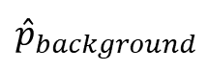
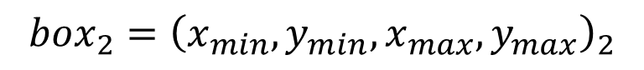
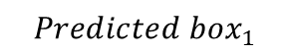
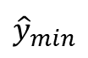
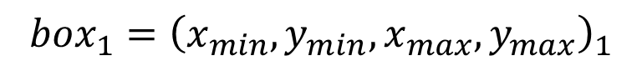
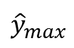
預測框增加到B個
$${\hat{x}}_{min}$$
$${Predicted box}_{1}$$
$${\hat{y}}_{min}$$
GAP
$${\hat{x}}_{max}$$
Backbone NetWork
…
$${\hat{y}}_{max}$$
…
…
$${\hat{x}}_{min}$$
$${Predicted box}_{B}$$
$${\hat{y}}_{min}$$
$${\hat{x}}_{max}$$
$${\hat{y}}_{max}$$
$${box}_{1}={\left(x_{min},y_{min},x_{max},y_{max}\right)}_{1}$$
$${\hat{p}}_{background}$$
$${Predicted box}_{1}$$
$${\hat{p}}_{object}$$
…
$${box}_{2}={\left(x_{min},y_{min},x_{max},y_{max}\right)}_{2}$$
…
$${\hat{p}}_{background}$$
$${Predicted box}_{B}$$
$${\hat{p}}_{object}$$

Slide 8
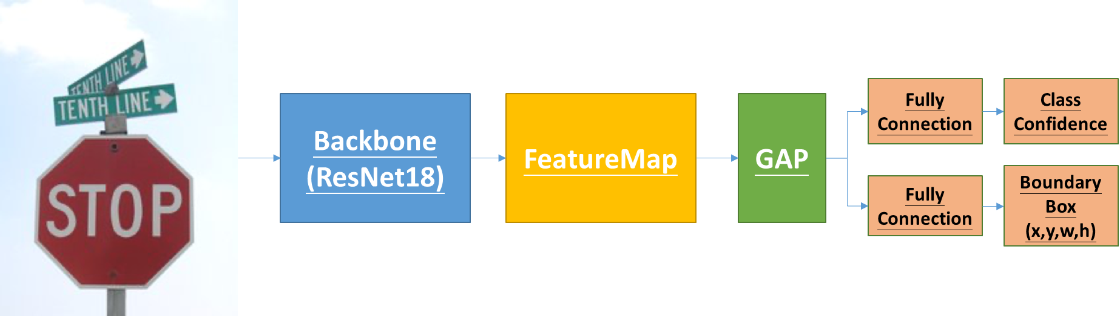
物件偵測
最後輸出預測5個物件框
Boundary Box輸出的特徵圖大小為
batch * (6*4)= batch * 24
Class Confidence輸出的特徵圖大小為
batch * (6*(n_class+1)) = batch * (6*5) = batch * 30

Slide 9
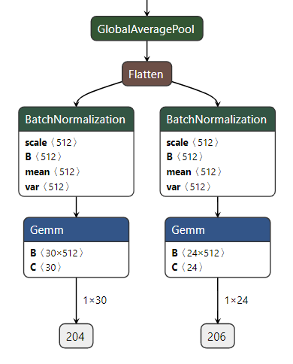
最後輸出預測6個物件框
Boundary Box輸出的特徵圖大小為
batch * (6*4)= batch * 24
Class Confidence輸出的特徵圖大小為
batch * (6*(n_class+1)) = batch * (6*5) = batch * 30

Slide 10
Objection Detection
Pytorch 操作
Jupyter Notebook

Slide 11
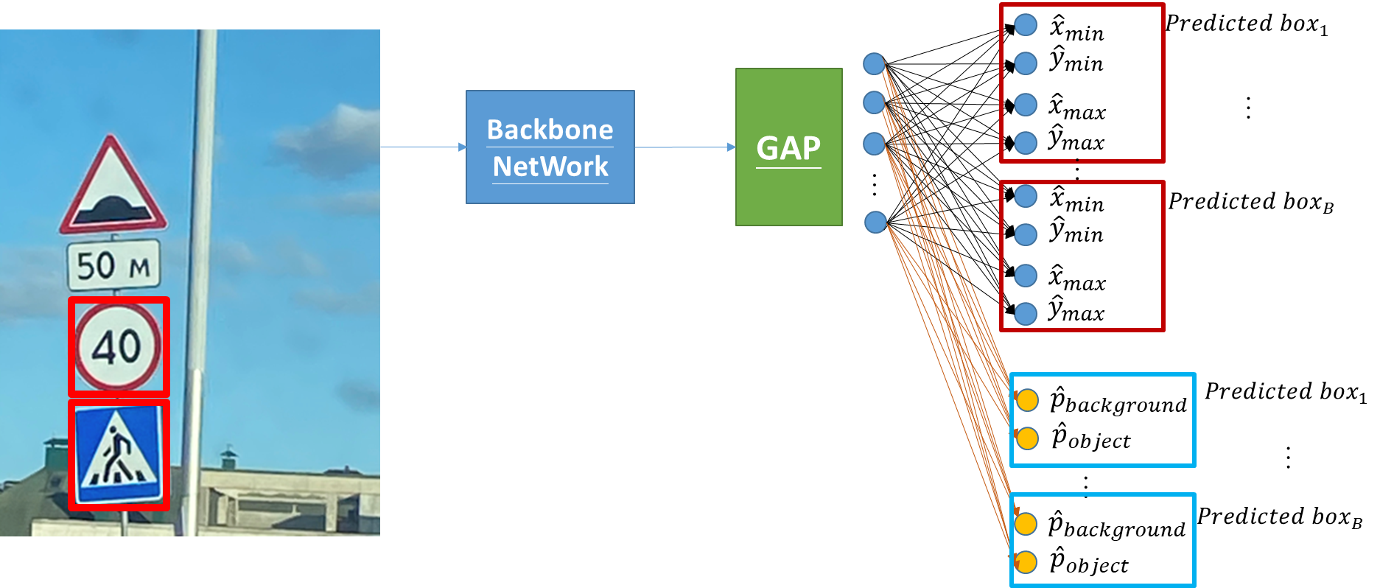
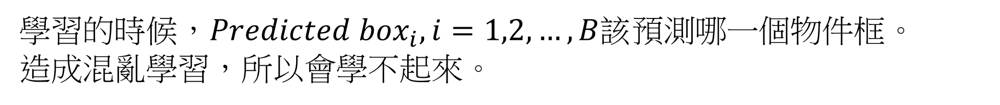
問題
?
學習的時候，${Predicted box}_{i}, i=1,2,…,B$該預測哪一個物件框。
造成混亂學習，所以會學不起來。

Slide 12
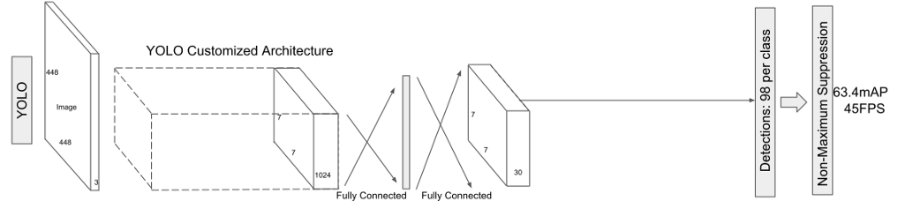
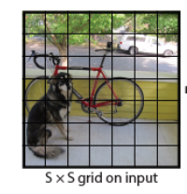
YOLOv1的detector怎麼處理
最後一層是7*7*30
7*7就是的grid cell
30 = 2×5+20
2: 2個Boundarybox
5: 每個Boundarybox (x, y, w, h, confidence)
20:屬於20個類別的機率。

Slide 13
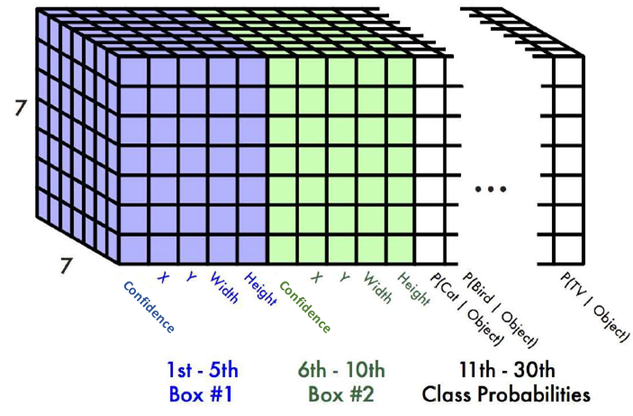
YOLOv1的detector怎麼處理
最後一層是7*7*30

Slide 14
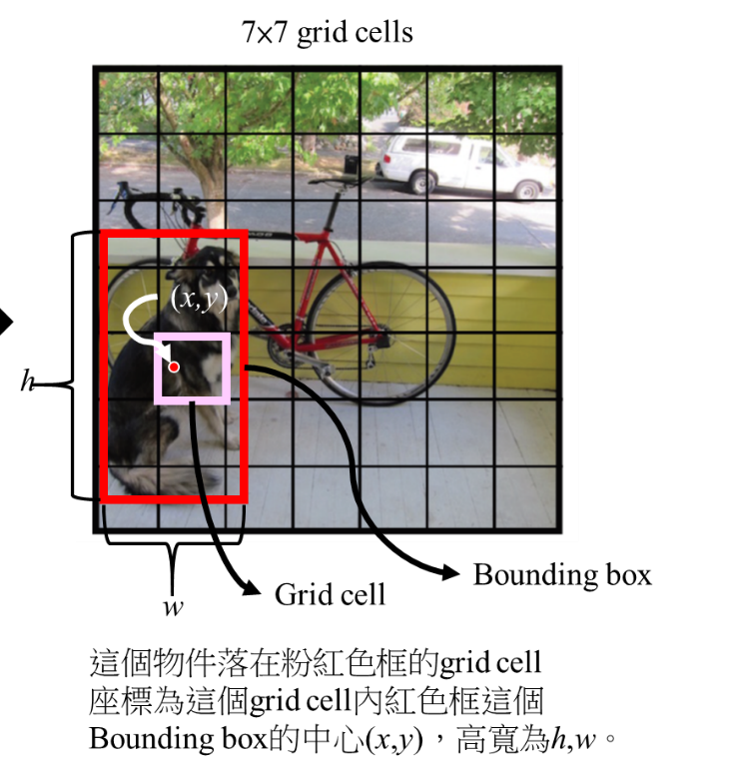
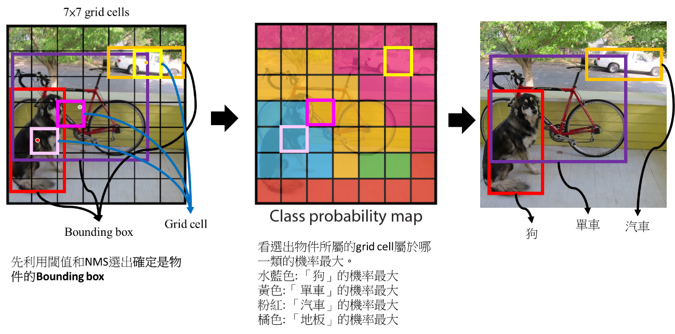
YOLOv1的detector怎麼處理
5: 每個Boundary box (x, y, w, h, confidence)
20:屬於20個類別的機率。

Slide 15
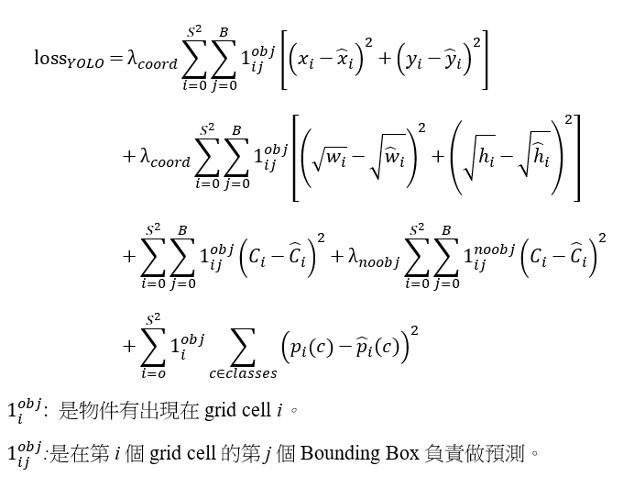
YOLOv1 loss function
物件的中心座標($x,y$)和模型預測BBOX座標($\hat{x},\hat{y}$)的均方差和
物件的長寬($w,h$)和模型預測BBOX長寬($\hat{w},\hat{h}$)的均方差和
這個grid cell有沒有物件的信心度
這個物件被判斷成每個類別的機率

Slide 16
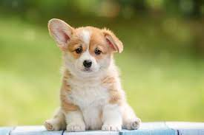
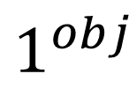
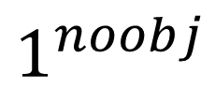
是不是有物件
$$1^{obj}$$
$$1^{noobj}$$
0 | 0 | 0 | 0 | 0 | 0 | 0
0 | 1 | 1 | 1 | 0 | 0 | 0
0 | 0 | 1 | 1 | 1 | 0 | 0
0 | 0 | 1 | 1 | 0 | 0 | 0
0 | 0 | 1 | 1 | 0 | 0 | 0
0 | 0 | 1 | 1 | 1 | 0 | 0
0 | 1 | 1 | 1 | 1 | 0 | 0
0 | 0 | 0 | 0 | 0 | 0 | 0
0 | 1 | 1 | 1 | 0 | 0 | 0
0 | 0 | 1 | 1 | 1 | 0 | 0
0 | 0 | 1 | 1 | 0 | 0 | 0
0 | 0 | 1 | 1 | 0 | 0 | 0
0 | 0 | 1 | 1 | 1 | 0 | 0
0 | 1 | 1 | 1 | 1 | 0 | 0
1 | 1 | 1 | 1 | 1 | 1 | 1
1 | 0 | 0 | 0 | 1 | 1 | 1
1 | 1 | 0 | 0 | 0 | 1 | 1
1 | 1 | 0 | 0 | 1 | 1 | 1
1 | 1 | 0 | 0 | 1 | 1 | 1
1 | 1 | 0 | 0 | 0 | 1 | 1
1 | 0 | 0 | 0 | 0 | 1 | 1

Slide 17
是不是有物件
物件框
0 | 0 | 0 | 0 | 0 | 0 | 0
0 | 1 | 1 | 1 | 1 | 0 | 0
0 | 1 | 1 | 1 | 1 | 0 | 0
0 | 1 | 1 | 1 | 1 | 0 | 0
0 | 1 | 1 | 1 | 1 | 0 | 0
0 | 1 | 1 | 1 | 1 | 0 | 0
0 | 1 | 1 | 1 | 1 | 0 | 0

Slide 18
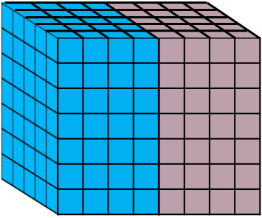
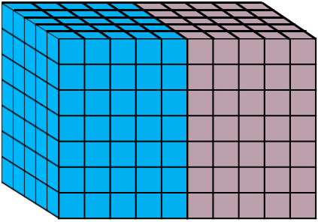
SSD detector
Boundary Box (5)
detector
Class confidence (C=4+1)
conv
Boundary Box (# anchor * 4)
Class confidence (# anchor *(C+1))
conv
Box2
(tx, ty, tw, th)
Box1
(tx, ty, tw, th)
Background
Probability for Box 2
Probability for Box 1

Slide 19
SSD vs YOLO
SSD detector
YOLO detector
conv
Boundary Box (# anchor * 4)
Boundary Box
+
class prob. (# anchor * ((4+1)+C))
conv
Class confidence (# anchor *(C+1))
conv

Slide 20
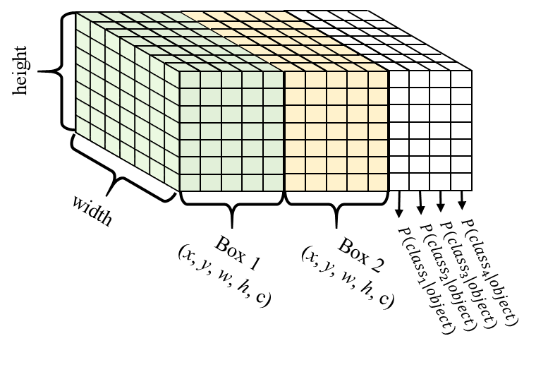
SSD vs YOLO
SSD
# class =4
YOLOv1
# class =4
最後一層是7*7*14
Boundary Box (5)
Class confidence (C=4+1)
Box2
(tx, ty, tw, th)
Box1
(tx, ty, tw, th)
Probability for Box 2
Probability for Box 1

Slide 21

SSD vs YOLO
SSD
# class =4
YOLOv2
# class =4
Boundary Box (5)
#Anchor * (5+4)
Class confidence (C=4+1)
Box2
(tx, ty, tw, th)
Box1
(tx, ty, tw, th)
Box2
(Confidence, tx, ty, tw, th)
Box 1
Class Probabilities (c=4)
Box 2
Class Probabilities (c=4)
Box1
(Confidence, tx, ty, tw, th)
Probability for Box 2
Probability for Box 1

